Slide 1
Digital System Design: Simultaneous Tone Generator
Ben Ulrich, Thomas Pinto, and Patrick Roscio
Spring 2024

Slide 2
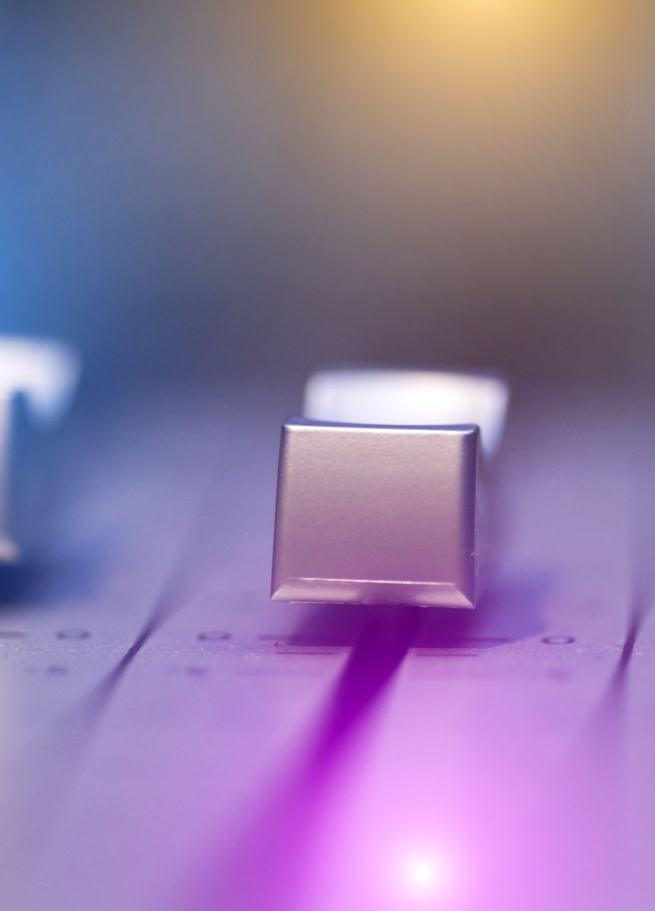
Objectives:
Develop a musical instrument that can:
Be able to play notes simultaneously to create chords.
Play at least one octave with the switch positions determining which note in the octave is played
Using the buttons on the board, determine if the notes are played using a square wave, triangle wave, or sawtooth wave.

Slide 3
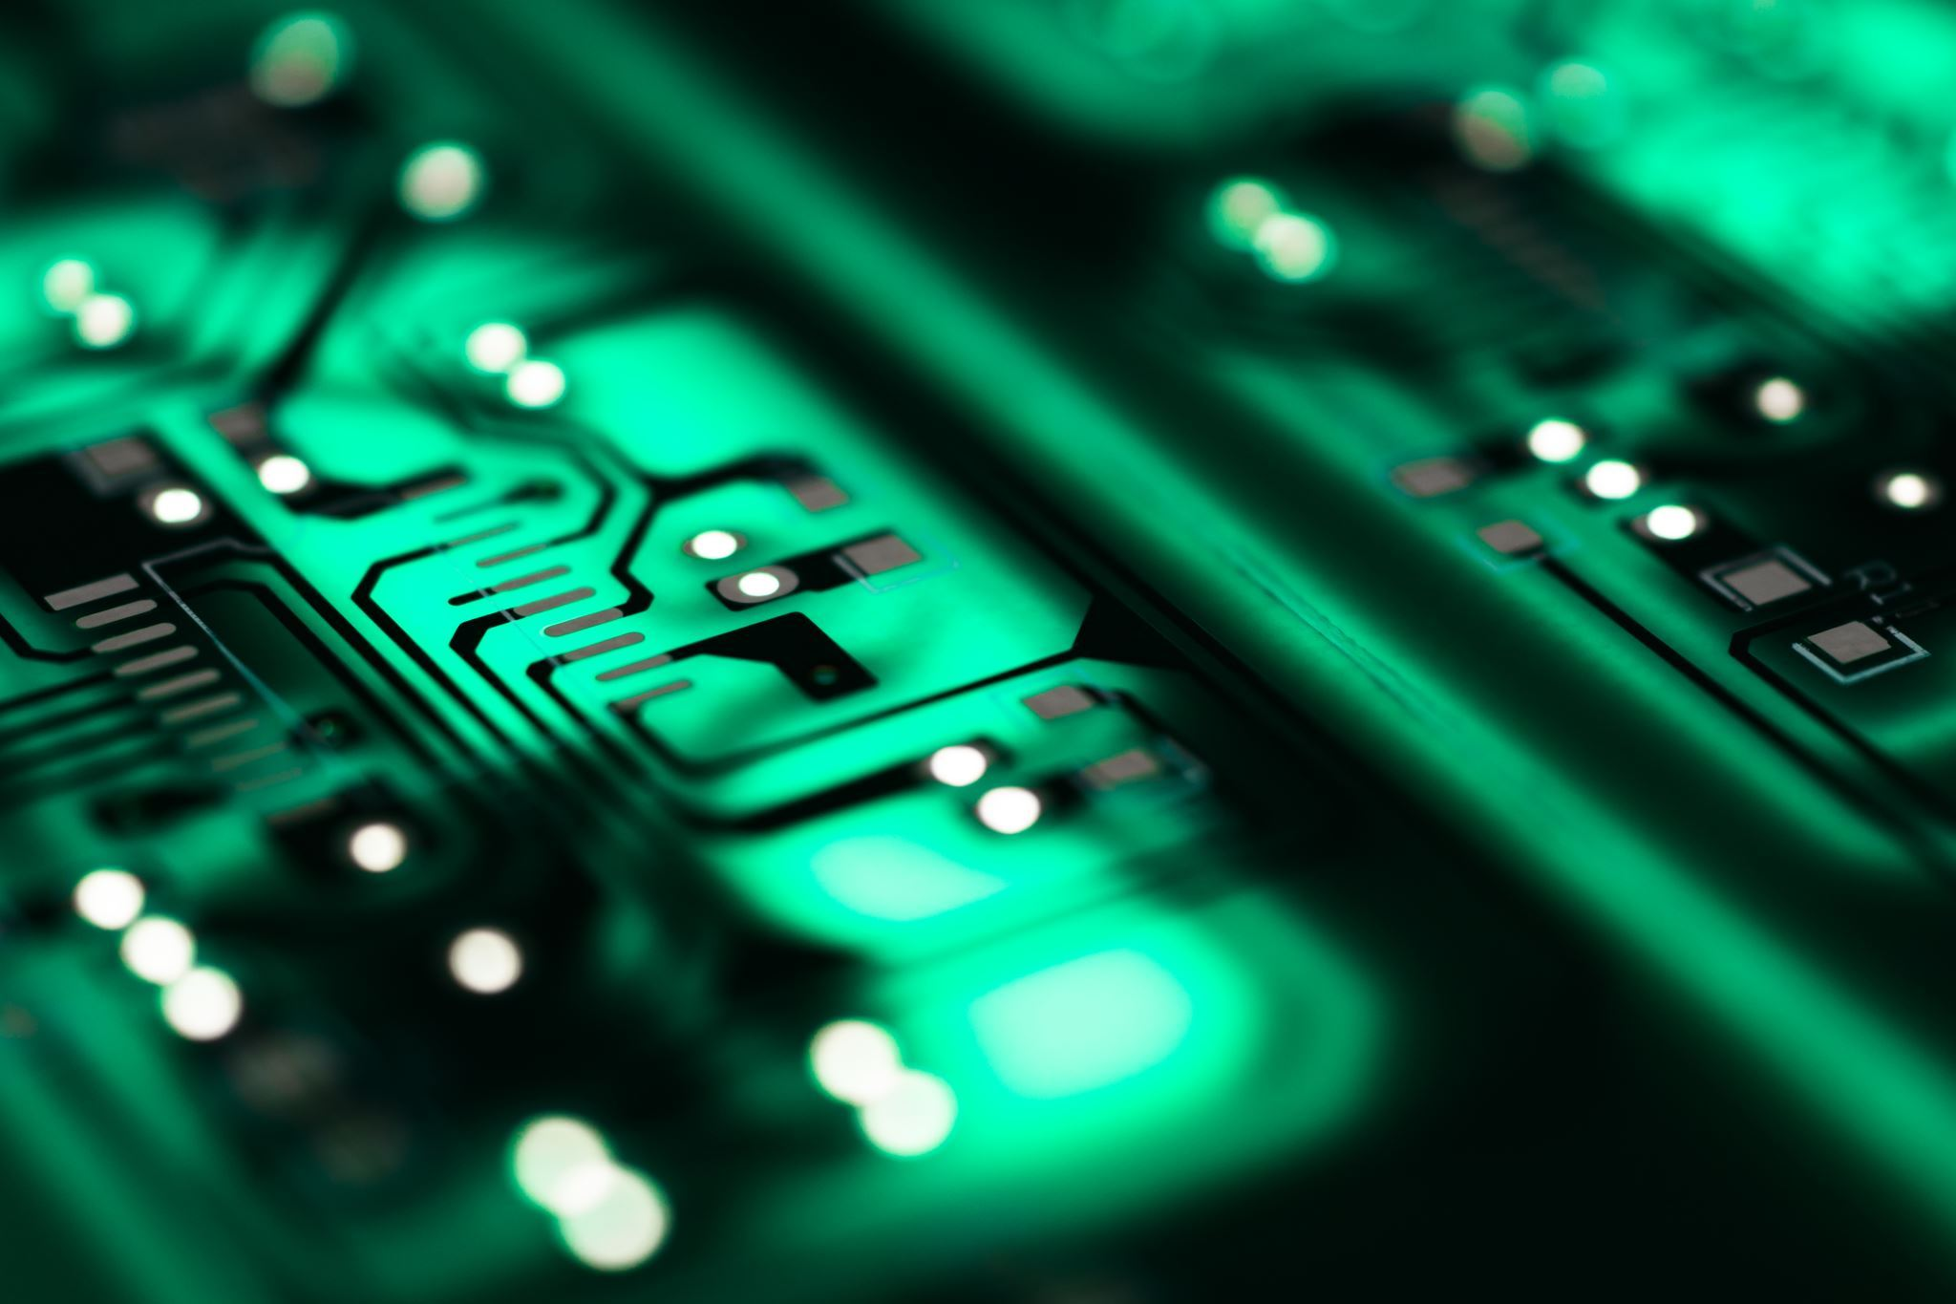
Initial Code:
Our initial Code was provided with Lab 5:
We used the tone.vhd, dac_if.vhd, siren.xdc and wrote a new file called TonePlayer.vhd
Dac_if.vhd is unaltered in form.
Tone had a new port input std_logic of switch
We used nmj

Slide 4
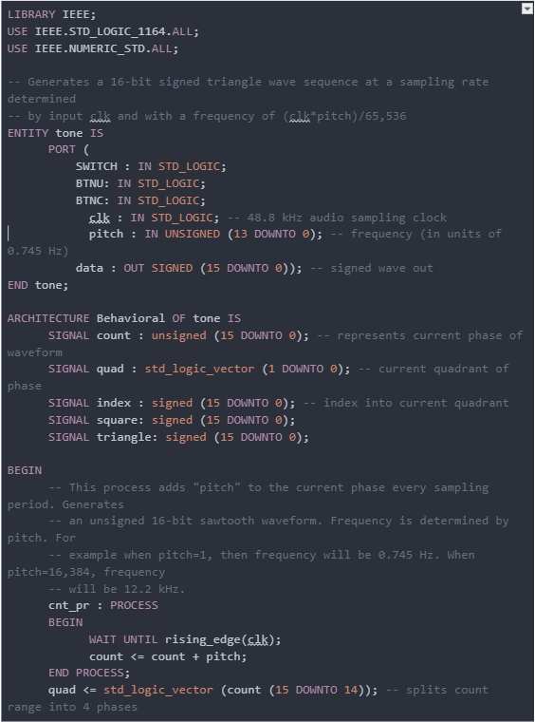
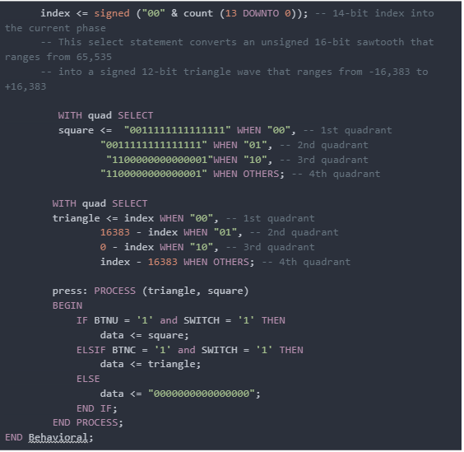

Modifications to Tone.vhd

Slide 5
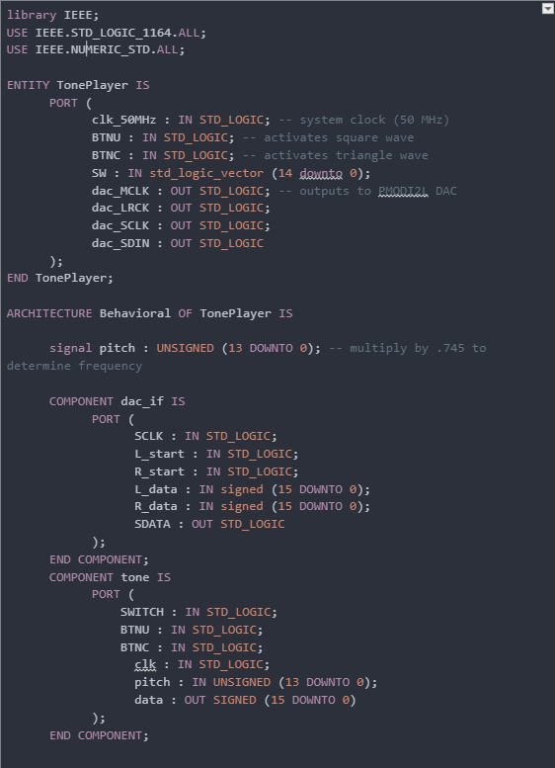
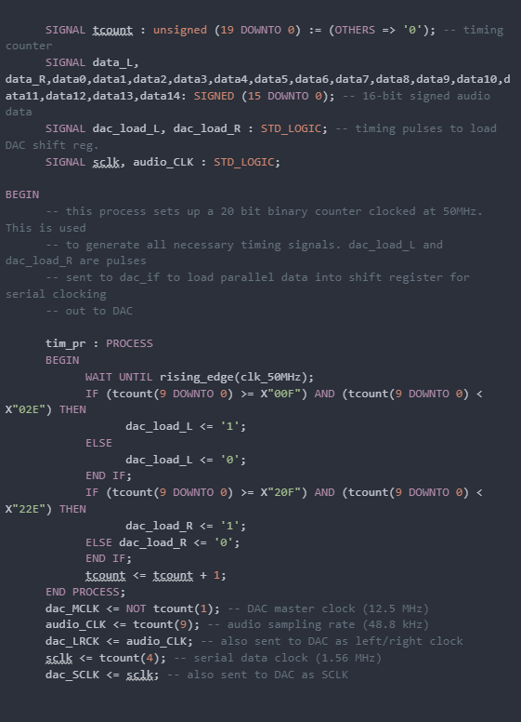


Creation of TonePlayer.VHDL

Slide 6
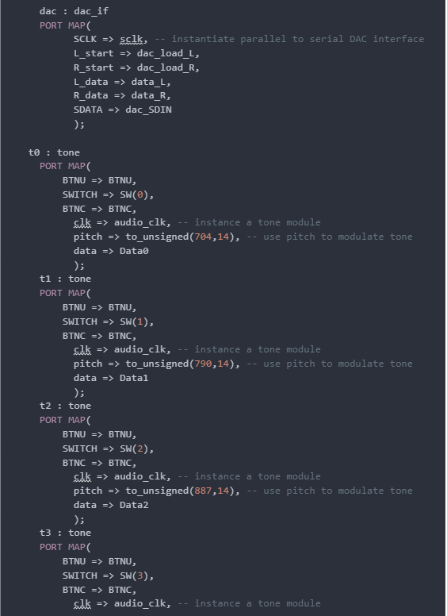
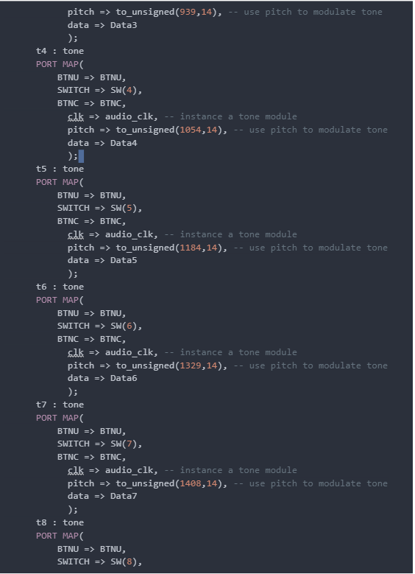
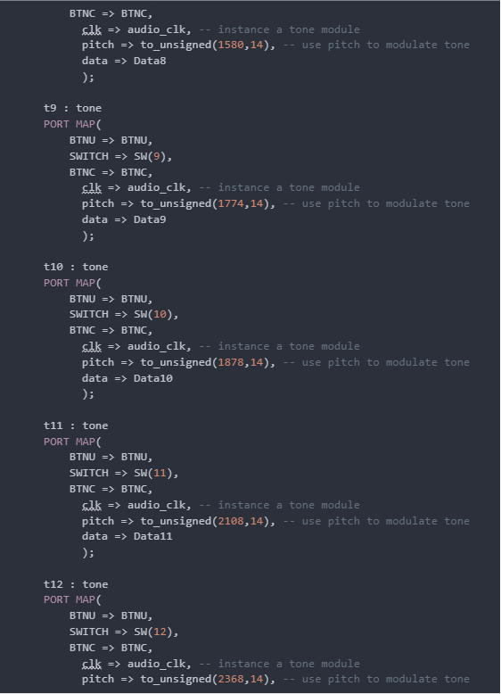
Addition of tone port-maps per Switch to TonePlayer.VHD

Slide 7
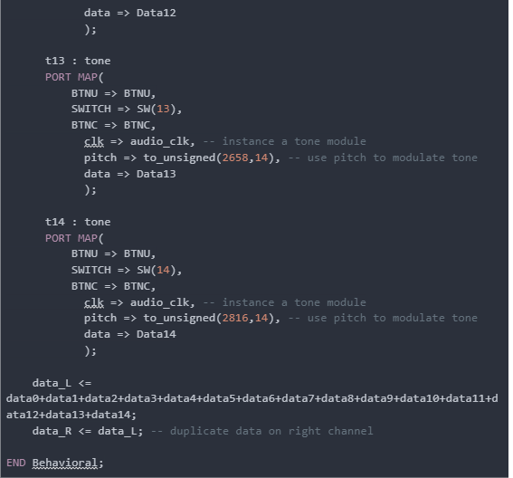

Data_L Signal Assignment in TonePlayer.VHDL

Slide 8
Structure
TonePlayer.vhd
t0 – t14
Siren.xdc
Dac_if.vhd
Tone.vhd
Each t# instance has a switch input (0-14) and a set frequency passed into the data stream for dac_if.vhd
Tone Player contains our three waves (square, sawtooth, and triangle) and the if statements to control which wave is used depending on the button position

Slide 9
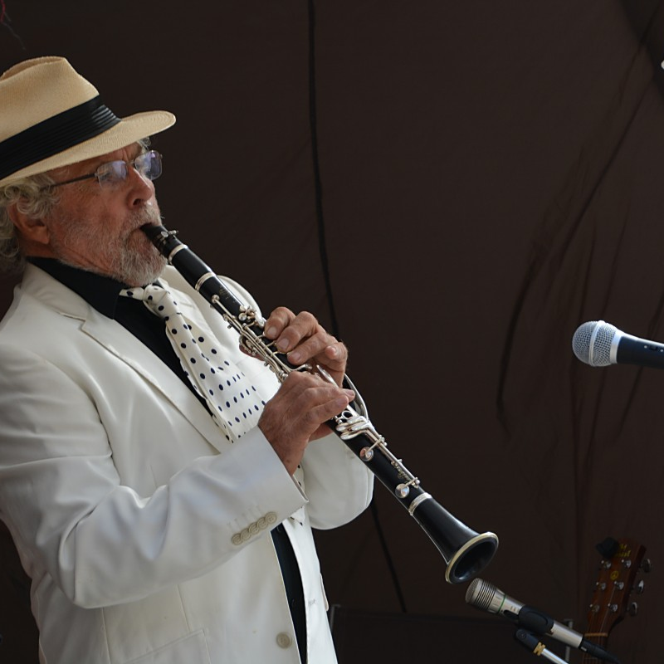
Demonstration
Performed by yours truly, Thomas Pinto

Slide 10
Challenges:
Some of the challenges within this project:
Determining what values corresponded to each note
Realized that we were doubling frequency for the waves
Missing inputs for switches, leading to a lack in generated tones
Turning triangle wave into a sawtooth wave
Previous implementation of sawtooth was done without regard to the actual tone
Speaker has difficulties trying to playback a chord(three notes in harmony)

Slide 11
Future Modifications
While we did accomplish all our objectives with the project, to improve upon our design we could additionally:
Output the note or notes being played on the LED display.
Use an external keyboard/keypad to play the notes as flipping the switches makes playing the instrument difficult.

Slide 12
Conclusion
Our project worked as expected and was able to play two octaves of notes on all 15 switches of the board.
We can play as many notes simultaneously as we would like to generate over 32,768 possible sounds (not all audible with the speaker we have)
Three waves: Square, and Triangle, and sawtooth can be played with any combination of notes delivering different “volume” levels to our instrument.

